Slide 1
Sunshine Coast Suburb Comparison

Slide 2
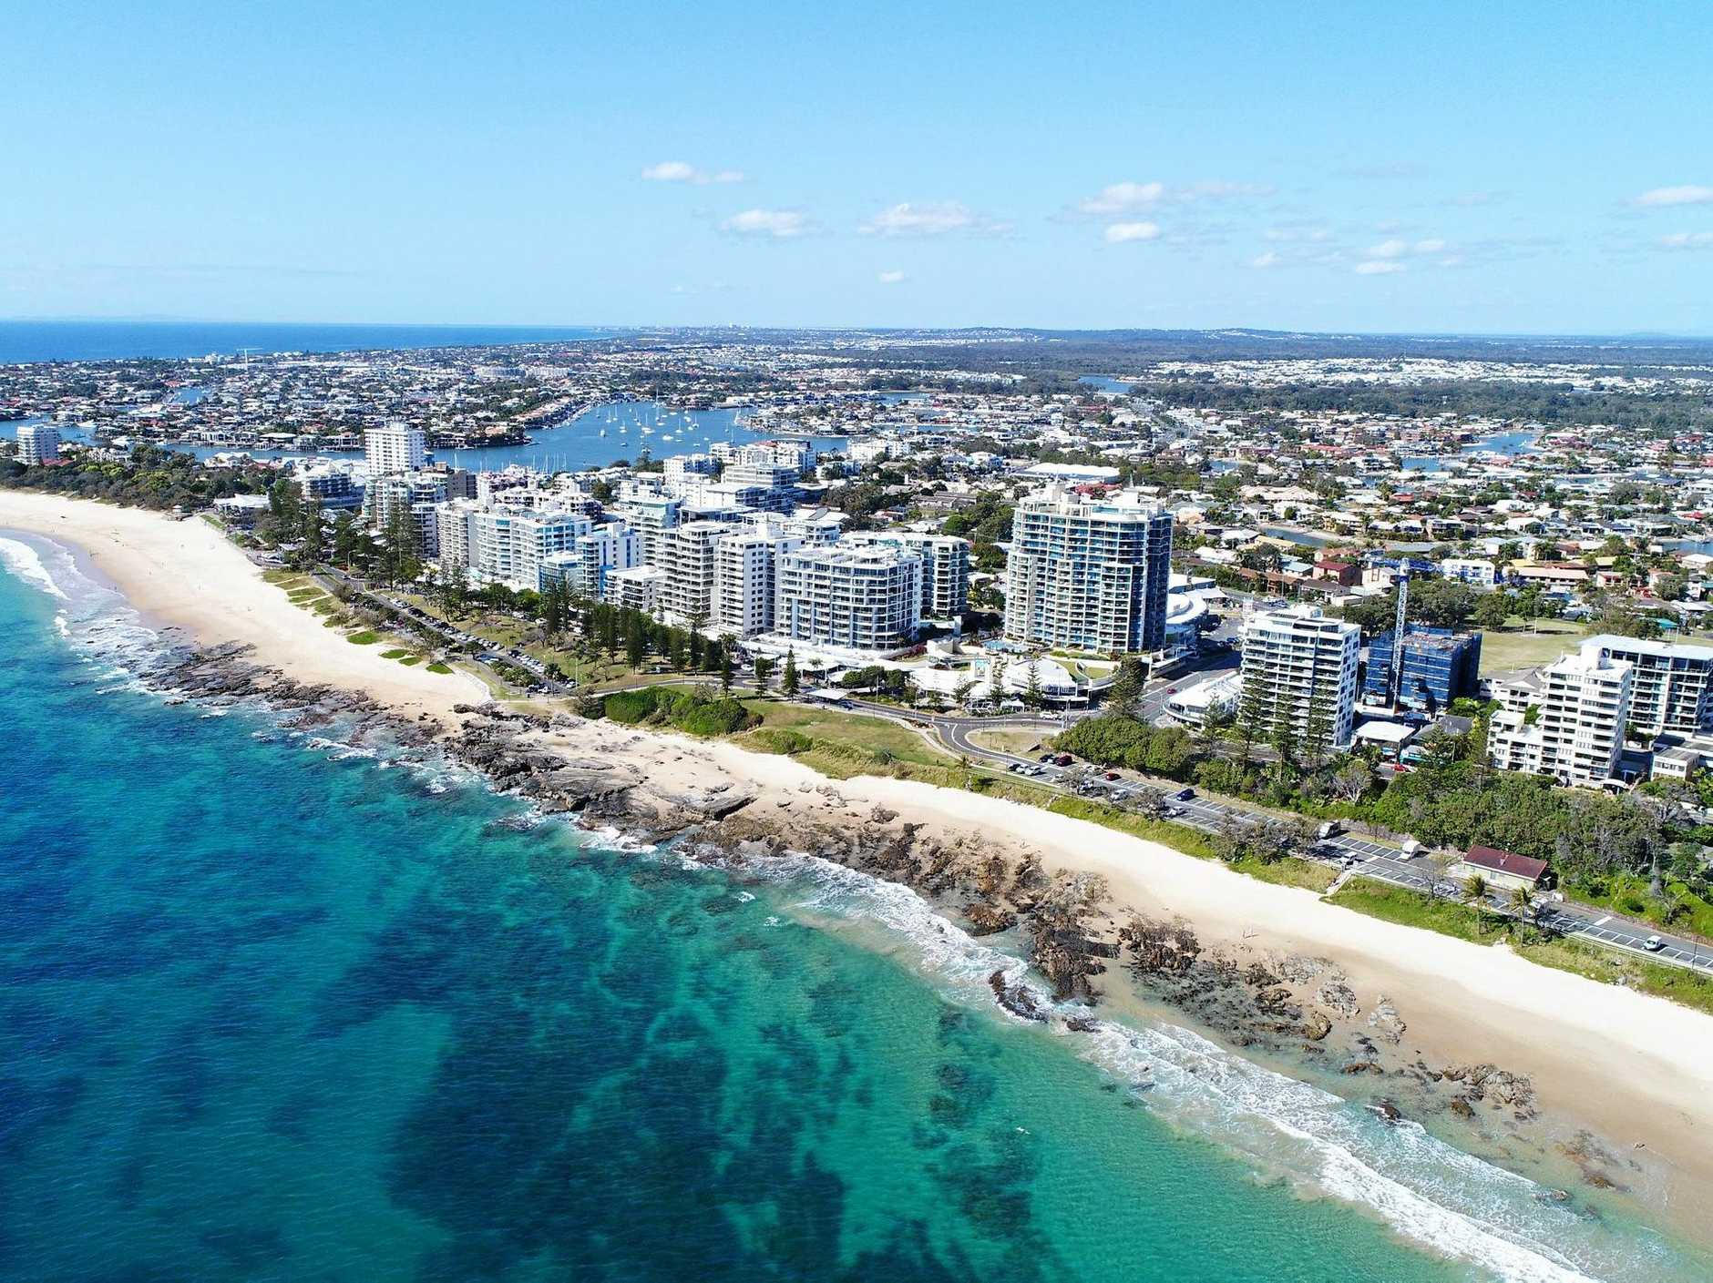
Introduction:
The Sunshine Coast is a costal area in Queensland, Australia
Located ~ 1.5h drive north of Brisbane
It is a location I hope to move to in August 2022.
Using Data analysis and Machine Learning, I hope to determine what part of the sunshine coast to move to.

Slide 3
Data Used:
Data which is utilised for this project includes:
Australian Postcode Location Data: https://www.corra.com.au/australian-postcode-location-data/
Sunshine Cost Postcode Data: https://www.geopostcodes.com/Sunshine_Coast
Foursquare mapping and location data

Slide 4
Methodology
Imported Australian Postcode Location Data, filtering by suburbs within the Sunshine Coast Area
Clean data and remove Na Values
Data analysis using Panadas package for Python
Foursquare API used to find venues within each suburb
K – Means clustering (sklearn package) to cluster suburbs into similar groups.

Slide 5
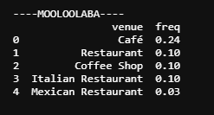
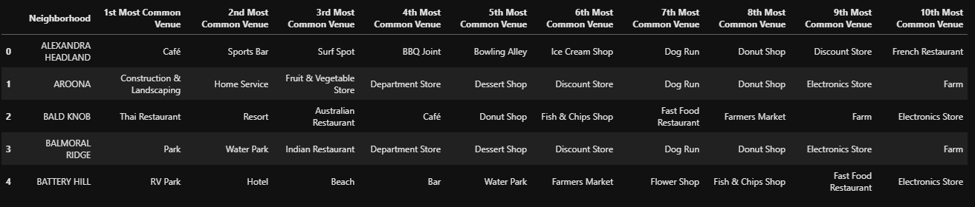
Results
160 Suburbs
517 Venues (119 unique catagories)
Mooloolaba had greatest number of venues (29)

Slide 6
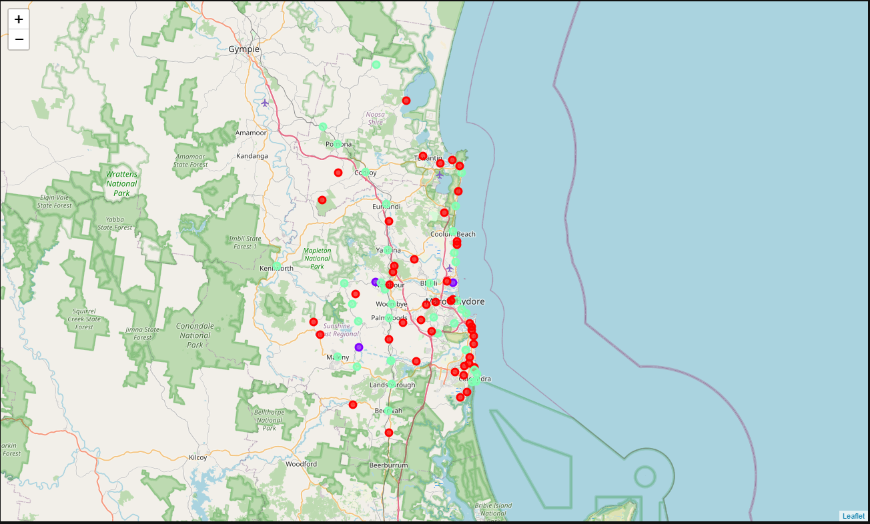
Results:

Slide 7
Discussion
3 clusters used in K-means (k = 3)
Cluster 0 (Red) mainly small coastal towns
Cluster 2 (Green) – Larger towns with cafés and resterants
Cluster 1 (Purple) - Outliers

Slide 8
Conclusion
Costal Locations within Cluster 2 appeared to be the best suited for me to move to.

